Slide 1
Project CASA: Final Project Presentation
May 25, 2017
Yevgeniya Chekh, Jan Kohout, David Löffler, Miroslav Rudišin, Kryštof Sýkora, Marek Szeles, Ho Minh Thanh

Slide 2
Presentation agenda
Introduction, what is CASA?
Review formal project outputs
Project run overview
Lessons learned, individual reviews

Slide 3
Who are we?
Team Role | Name | Contact
Project Lead | Marek Szeles | szelemar@fel.cvut.cz
Analyst | Ho Minh Thanh | homintha@fel.cvut.cz
Head of Development | David Löffler | loffldav@fel.cvut.cz
Head of Testing | Kryštof Sýkora | sykorkry@fel.cvut.cz
Developer | Miroslav Rudišin | rudismi1@fel.cvut.cz
Developer | Jan Kohout | kohouj13@fel.cvut.cz
Tester | Yevgeniya Chekh | chekhyev@fel.cvut.cz

Slide 4
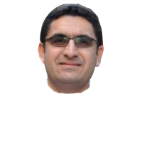
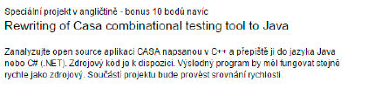
What is CASA?

Slide 5
So… Is CASA a success?
Yes!
No!
Jein?!

Slide 6
Why?
Meetings: 16
Steering Workshops held: 5 (so far)
Documents created: x
Spanning over: x pages
Lines of code worked on: 323 198

Slide 7
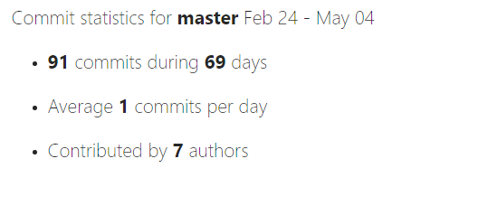
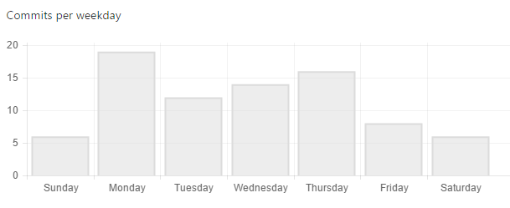
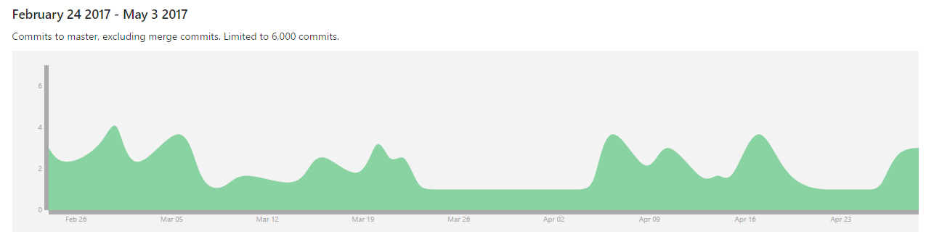
Also why?

Slide 8
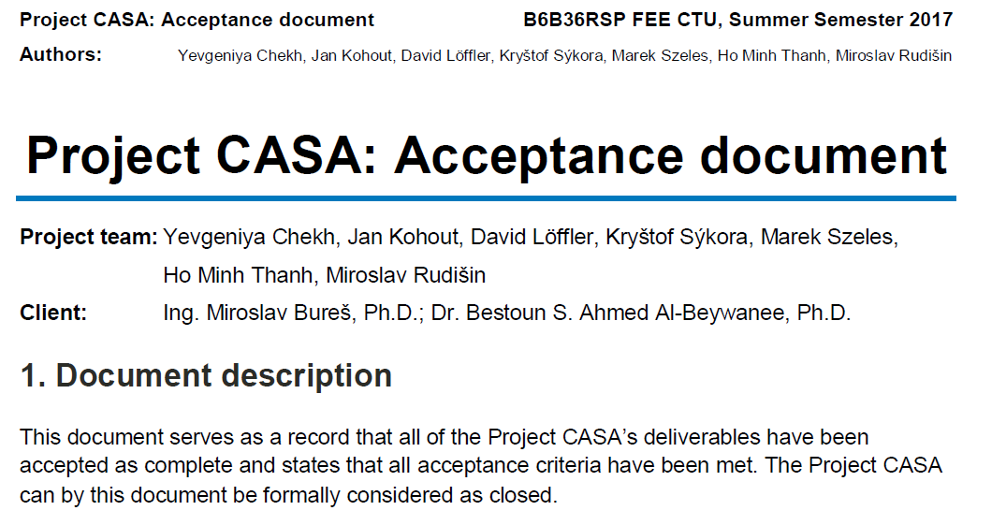
And finally…

Slide 9
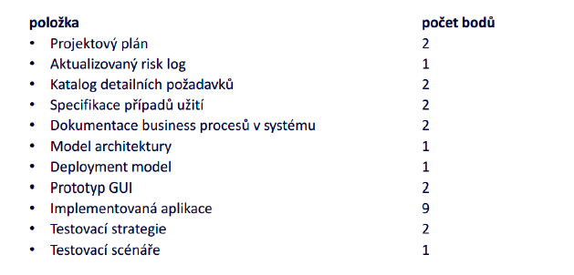
Let‘s take a look at the official rules though:
1
2
3
4
5
6
7
8
9
10
11

Slide 10
Let‘s take a look at the official rules though:
1
2
3
4
5
6
7
8
9
10
11

Slide 11
Project plan
1

Slide 12
Risk log
2

Slide 13
Detailed requirements specification
3

Slide 14
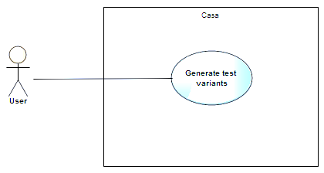
Use case specification
4

Slide 15
Analytics slides

Slide 16
Analysis – What are we doing?
First step: Read the documentation - success
Second step: Understand the documentation – failed
Third step: Ask Bestoun S. Ahmed - success

Slide 17


Analysis - Full Project View
1
2.1
2
1.1
1.2
2.2
1.3
1.5
1.4
Legend
1.7
Header file
1.6
C file
3
Dependency
3.1
3.2

Slide 18
Analysis – We don‘t want to reinvent wheels.
What modules can we run in C++? – None
Are there modules in Java we can use? – Yes, SAT

Slide 19
Development slides

Slide 20
Development progress
Starting with package with least dependencies
CASA
1
3
1
2
casa
2
3
common
minisat
1.1
1.1
1.5
1.5
2.1
2.1
3.1
algorithms
io
posix
3.1
solver
1.2
1.2
1.6
1.6
2.2
2.2
3.2
annealing
sat
utility
3.2
include
1.3
1.7
1.3
1.7
covering
search
1.4
1.4
events
Main.C

Slide 21
Full Project View: Starting point
1
2.1
2
1.1
1.2
2.2
1.3
1.5
1.4
1.7
1.6
3
3.1
3.2

Slide 22
Full Project View: Current status
1
2.1
2
1.1
1.2
2.2
1.3
1.5
1.4
Legend
1.7
Not started
1.6
In progress
3
Finished
3.1
3.2

Slide 23
Testing slides

Slide 24
Old slides

Slide 25
Project is being steadily updated…

Slide 26
…and we are still within planned schedule
Feb
Mar
Apr
May
Activity
08
09
10
11
12
13
14
15
16
17
18
19
20
21
Project Scope Analysis
CASA Architecture Mapping
Documentation Creation
Development in Java
Testing
SteerCo Meetings
Milestones
23. Feb 2017
Team Assembly
02. Mar 2017
Proposal Agreement
16. Mar 2017
Start of
Development
27. Apr 2017
Testing Phase
25. May 2017
Final outcome
hand-in
We are
here
Rector day off

Slide 27
Today we need to:
Resolve change requests
Discuss translation problems
Revise testing strategy
We would like to implement some changes to the original code in the two parsing modules
See attachment (ChR: Parsing Analysis)
Some problems have arisen during code translation
In some modules, test stubs are already in place -

Slide 28
Development update

Slide 29
Development progress
CASA
1
2
3
casa
common
minisat
1.1
1.5
2.1
3.1
algorithms
io
posix
solver
1.2
1.6
2.2
3.2
annealing
sat
utility
include
1.3
1.7
covering
search
1.4
events
Main.C

Slide 30
Full Project View: Last meeting (20.4.2017)
1
2.1
2
1.1
1.2
2.2
1.3
1.5
1.4
Legend
Not started
1.7
1.6
In progress
3
Finished
3.1
3.2
Change request

Slide 31
Full Project View: Current status (4.5.2017)
1
2.1
2
1.1
1.2
2.2
1.3
1.5
1.4
Legend
Not started
1.7
1.6
In progress
3
Finished
3.1
3.2
Change request

Slide 32
Testing update

Slide 33
High-level View
CASA
1
2
3
casa
common
minisat
1.1
1.5
2.1
3.1
algorithms
io
posix
solver
1.2
1.6
2.2
3.2
annealing
sat
utility
include
1.3
1.7
covering
search
1.4
events
Main.C

Slide 34
Unit testing overview
1
2.1
2
1.1
1.2
2.2
1.3
1.5
1.4
Legend
Not started
1.7
1.6
In progress
3
Finished
3.1
3.2
Change request

